Slide 1
Guess the number

Slide 2


1 to 100
49
49

Slide 3
1 to 100
71
49
71

Slide 4
1 to 100
24
49
24

Slide 5
1 to 100
Label_Min
Label_Max
?
?
Textbox_Guess

Slide 6
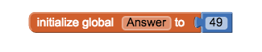
Variable
Stored data with name.
Name
Value

Slide 7
1 to 100
Label_Min
Label_Max
49
?
Textbox_Guess
Answer

Slide 8
1 to 100
Label_Min
Label_Max
?
?
Textbox_Guess
Answer

Slide 9
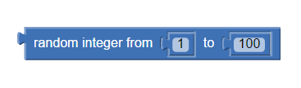
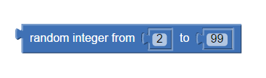

Random
Do not know exact value.
1 to 100
2 to 99

Slide 10
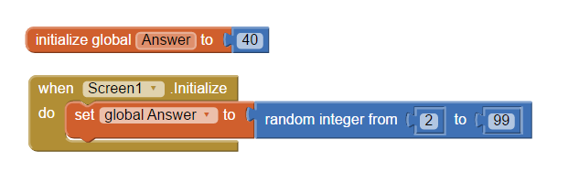

Random

Slide 11
1 to 100
49
49

Slide 12
Guess = Answer
Yes
Bingo
No
Guess > Answer
Yes
Change Label_Max
No
Guess < Answer
Yes
Change Label_Min
No

Slide 13
1 to 100
71
49
71

Slide 14
1 to 100
24
49
24

Slide 15
Guess = Answer
Yes
Bingo
No
Guess > Answer
Yes
Change Label_Max
No
Guess < Answer
Yes
Change Label_Min
No

Slide 16
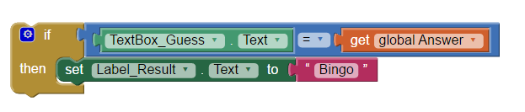
Selection
A “yes/no” with given condition.
If…then…
Do the blocks if the condition is true

